Slide 1

D.C Residential Property Sales Analysis
DSCI-6007-02- Distributed & Scalable Data Engr

Slide 2
Team Members:
Swarup
(Team leader)
Data Scientist
Shrestha
ML Engineer
Nikesh
Data Engineer

Slide 3

Background Analysis– Washington D.C. Population
2010–2020
D.C.'s population grew 15% from 2010 to 2020
2020
Nearly 690,000 residents in 2020
2021
Lost about 20,000 residents in 2021
Jan. 2023
As of January 2023, D.C currently has about 671,000 residents

Slide 4

Our Dataset:
Source: Open Data DC https://opendata.dc.gov/datasets/DCGIS::computer-assisted-mass-appraisal-residential/explore
Describes the sale history for active properties listed among the District of Columbia’s real property tax assessment roll
All housing types included
About 108,996 rows and 39 columns describing property attributes

Slide 5
Business Questions:
1. What are the characteristics of an average residential property?
Which heating type is the most common in residential properties in this dataset, and what is the percentage of properties with this heating type?
What is the average number of bathrooms and half-bathrooms in residential properties in this dataset?
What is the average land area of residential properties in this dataset, and how does this vary by number of bedrooms?
How has the gross building area of residential properties in this dataset changed over time?
2. Which variables have an impact on sale price, and how strong is that impact?
Is there a correlation between the number of bedrooms and the sale price of a residential property in this dataset?
Is there a correlation between the grade and the sale price of a residential property in this dataset?
Is there a correlation between gross building area and sale price?
3. Did COVID-19 have an impact on residential sale prices? If so how big was that impact?

Slide 6
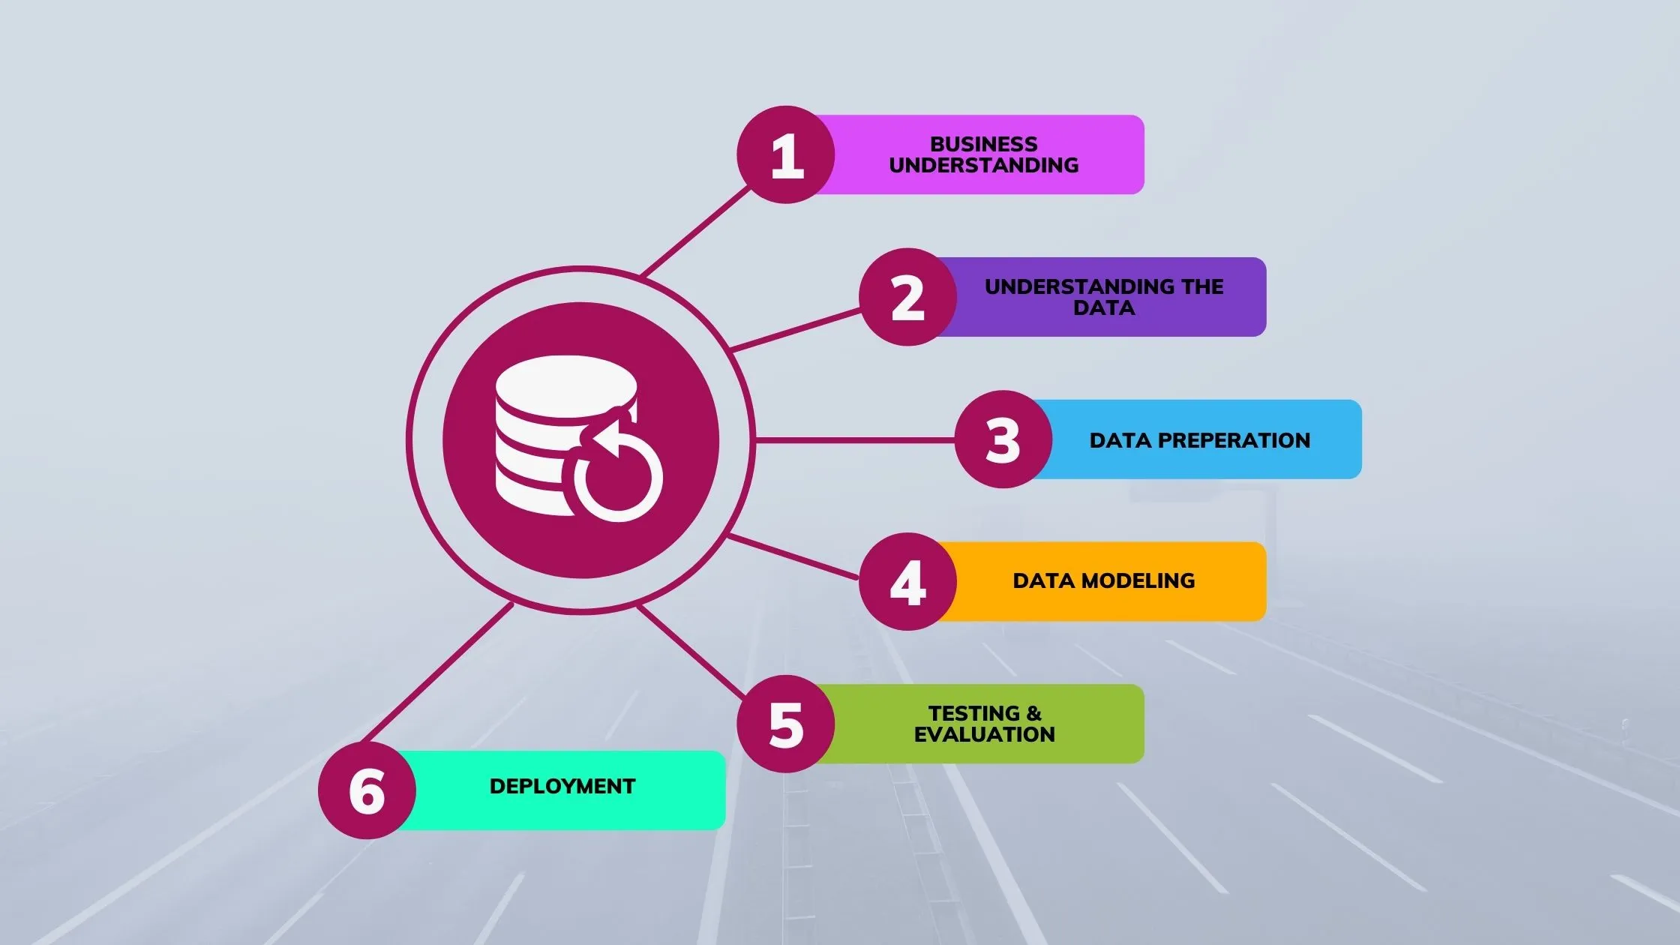
CRISP-DM METHEDOLOGY:

Slide 7






(Data Source)
(ETL)
Query
Prepared Data
(Model Deployment)
Inference

Slide 8
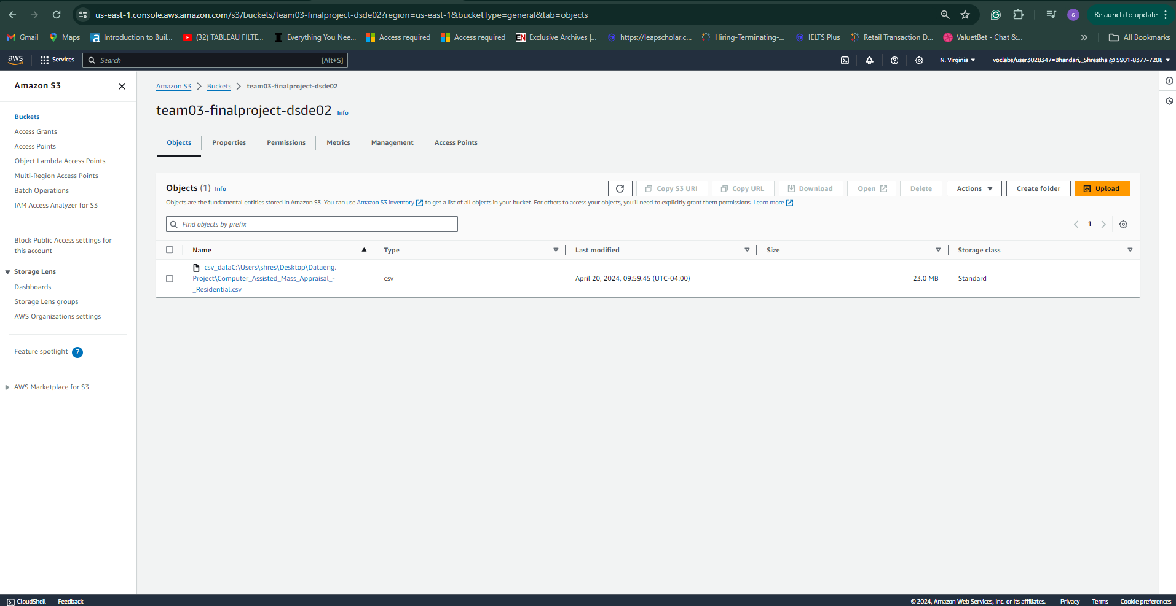
Load the Dataset in S3:

Slide 9
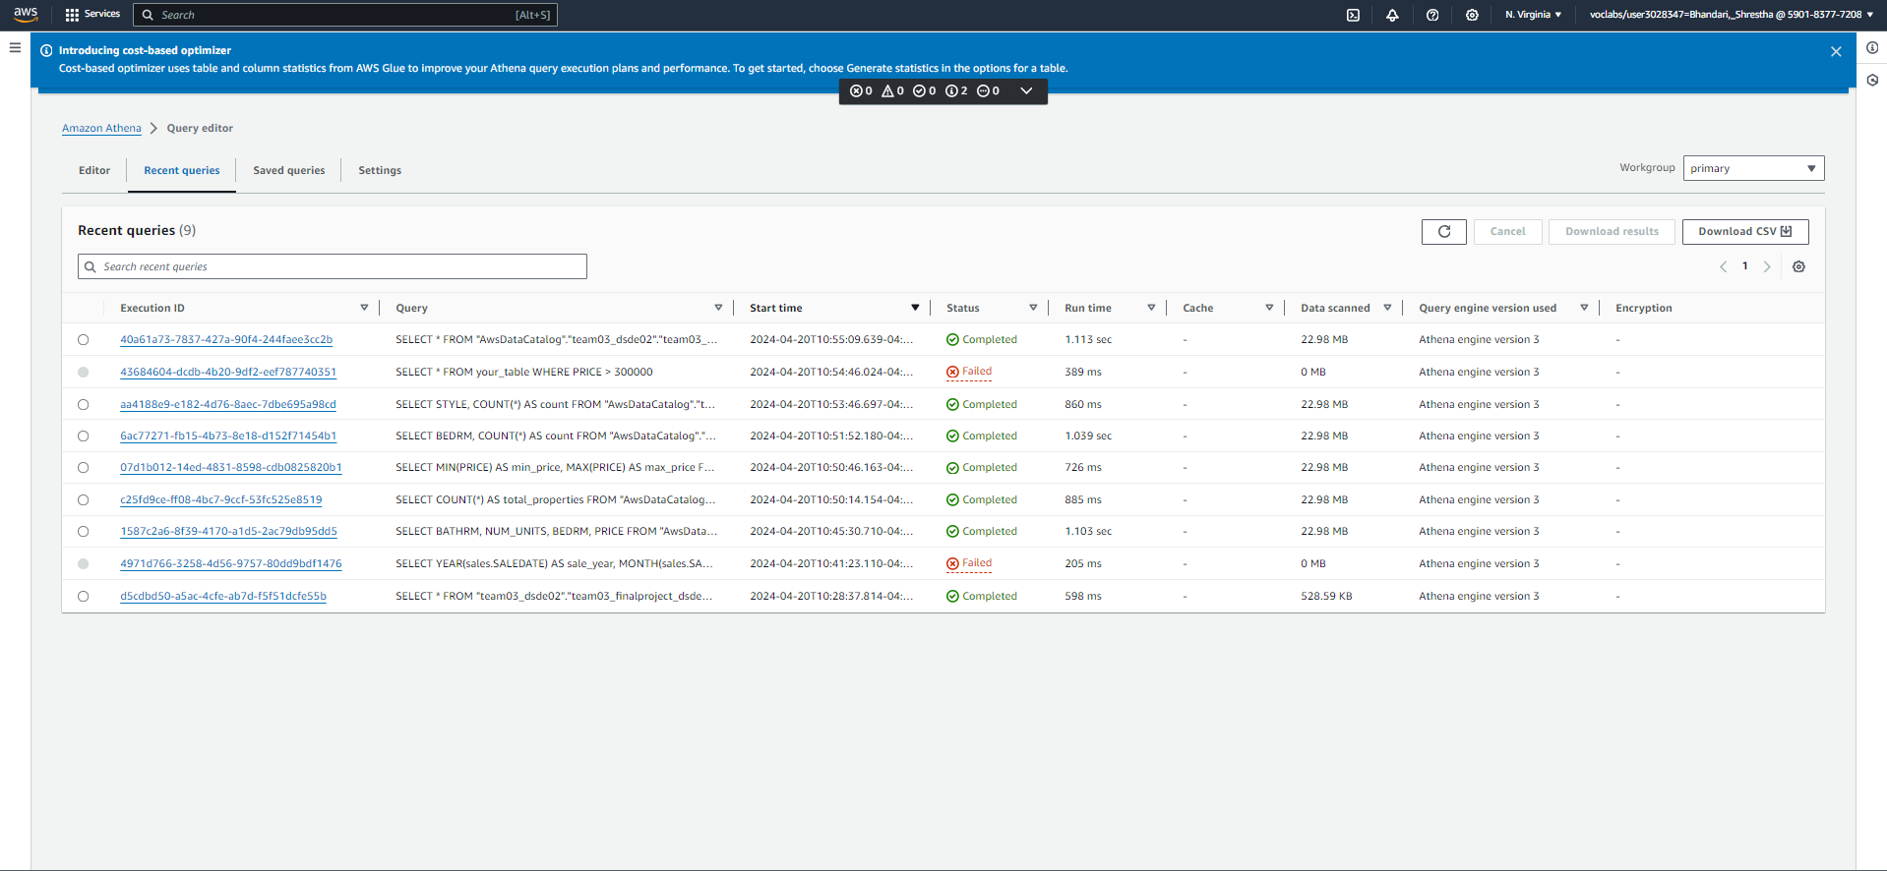
Query & Understanding Data:

Slide 10
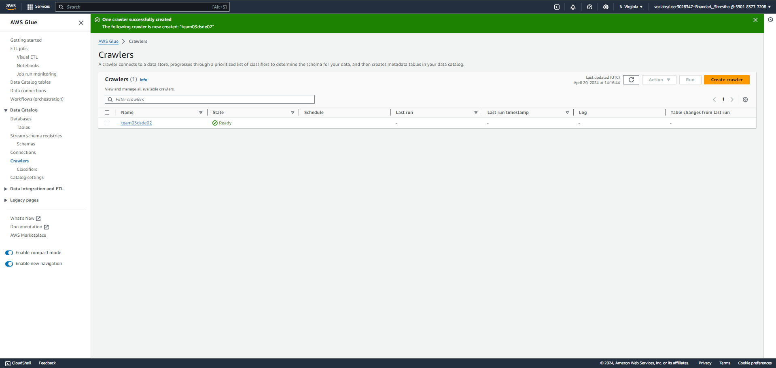
AWS Glue:

Slide 11
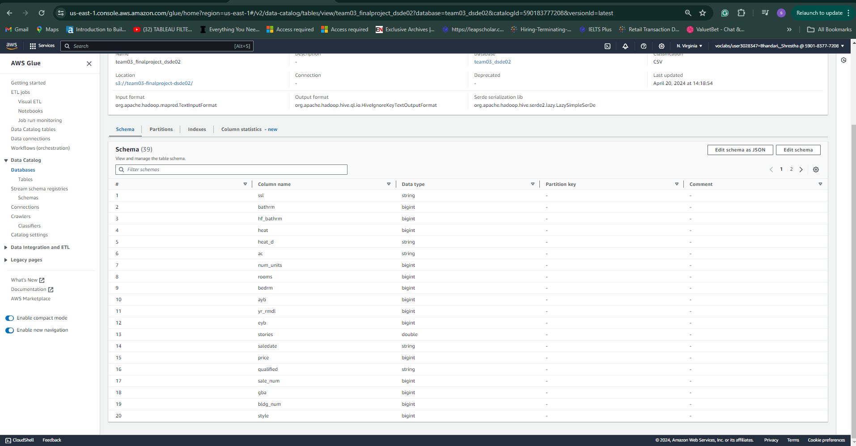
Loading Data to Schema:

Slide 12
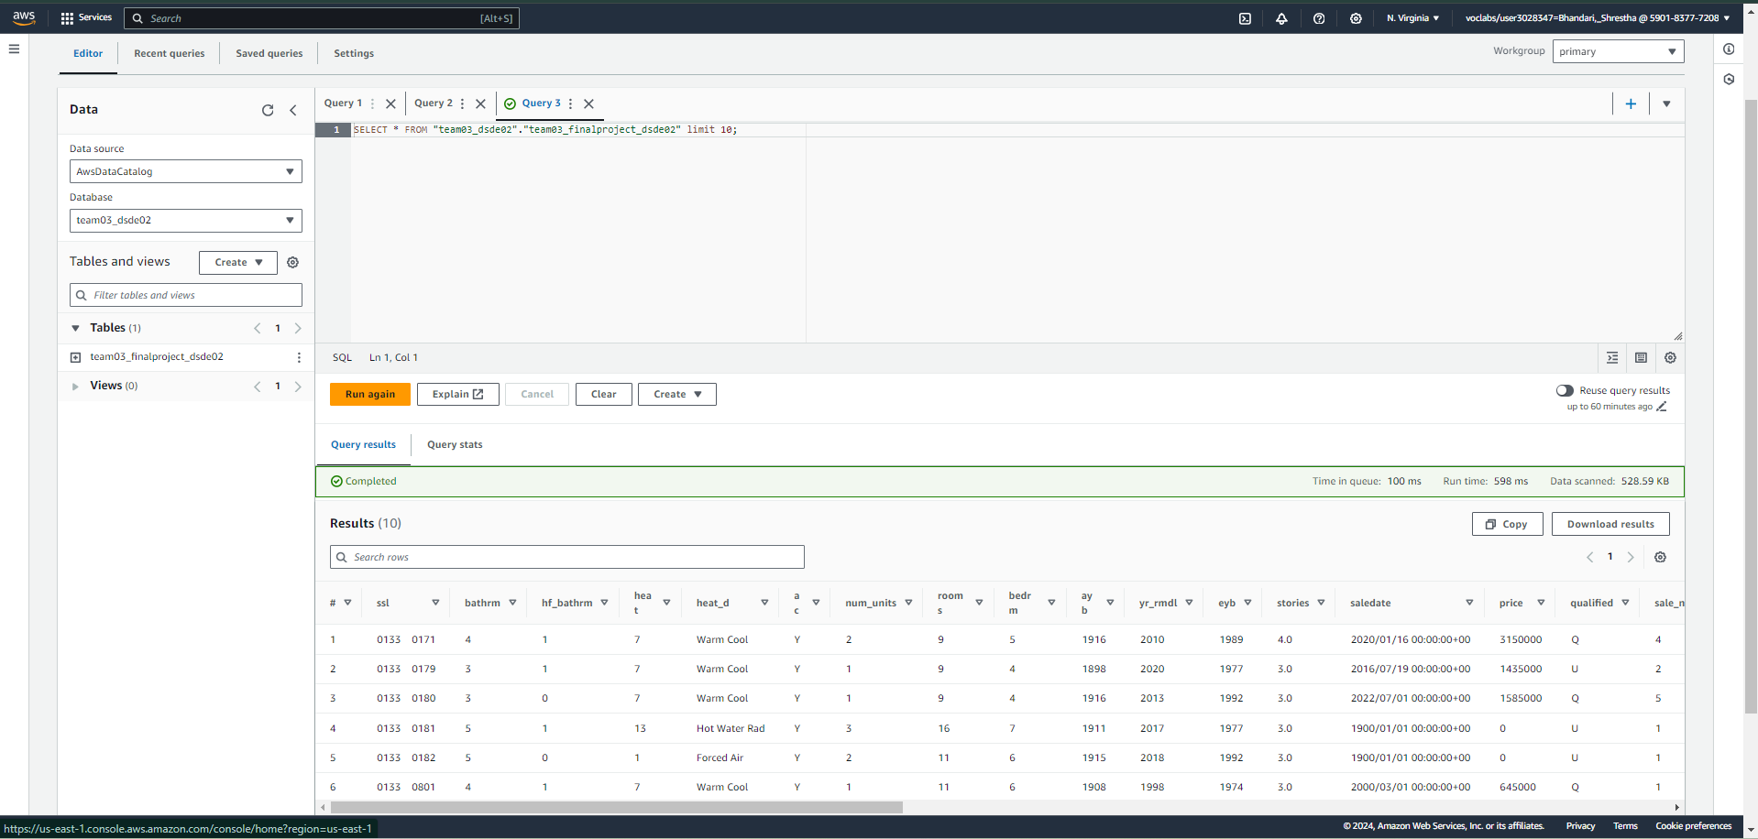
Transforming the Clean Data:

Slide 13
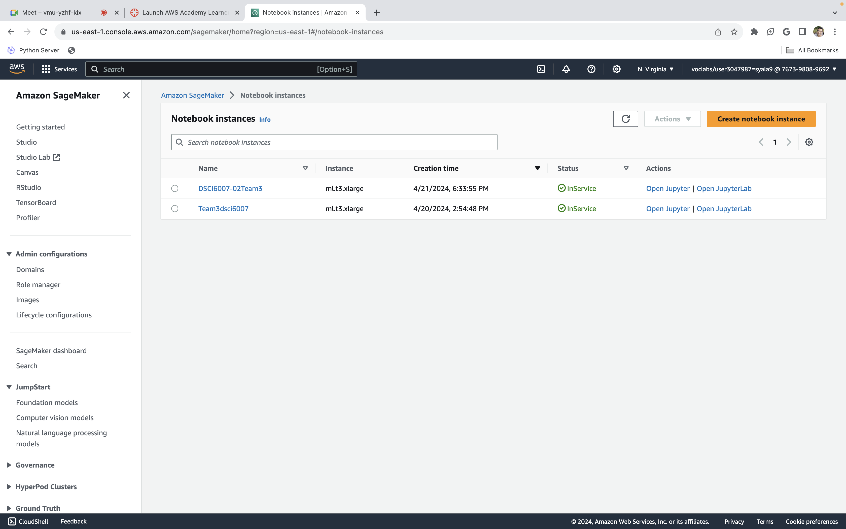
AWS Sagemaker:

Slide 14
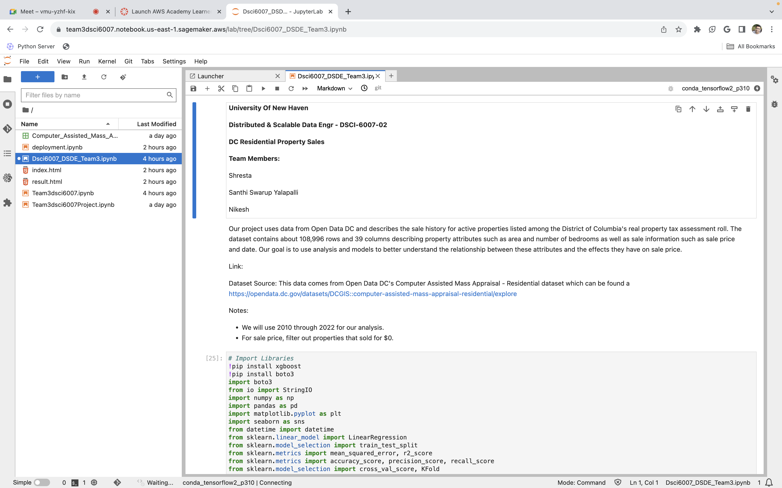
Sagemaker Notebook Instances:

Slide 15

Exploratory Data Analysis

Slide 16
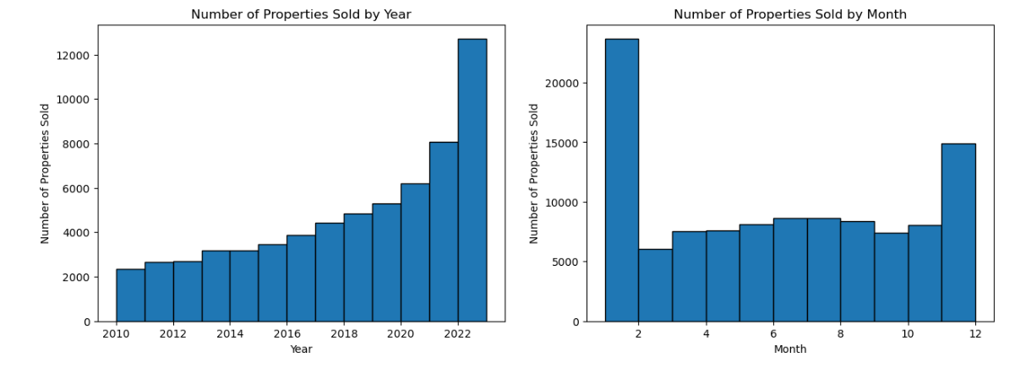
Annual and Monthly Property Sales Trends

Slide 17
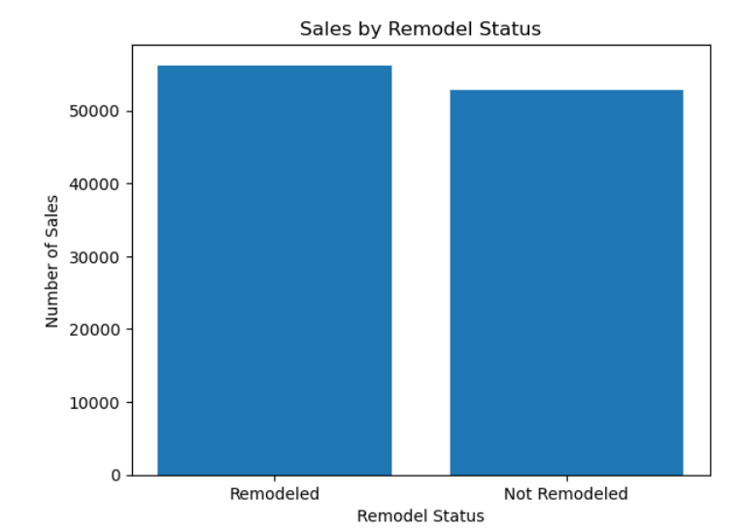
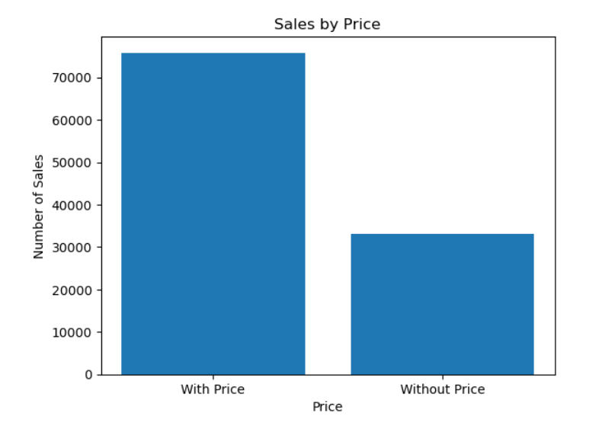
Property Sales by Price and Remodeled Status

Slide 18
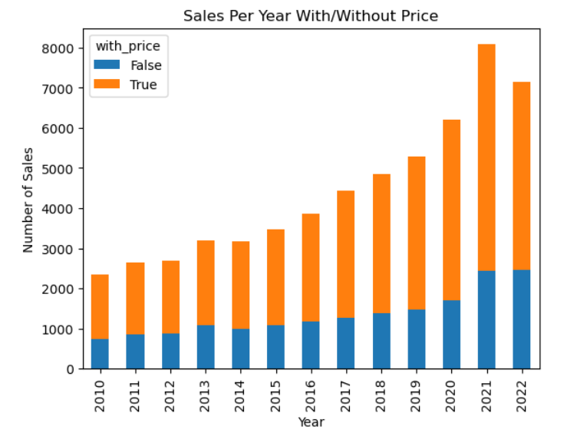
Annual Property Sales Comparison with and without Price

Slide 19
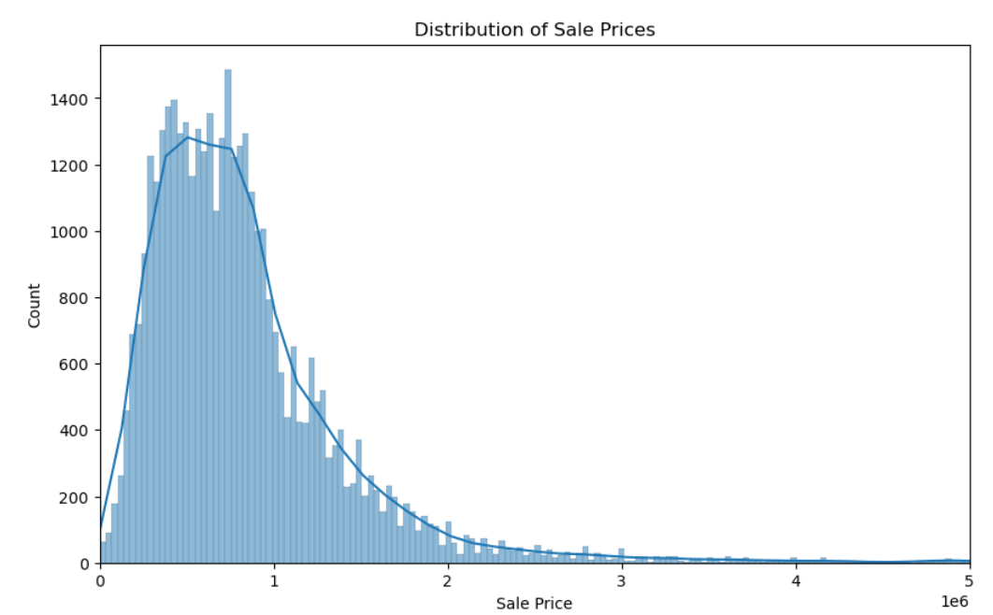
Distribution of Sale Prices for Trimmed Sales Data with KDE Plot

Slide 20
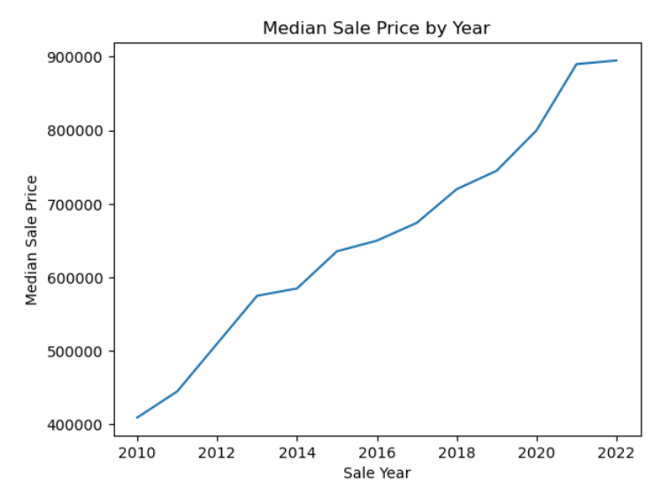
Median Sale Price by Year: Trend Analysis

Slide 21
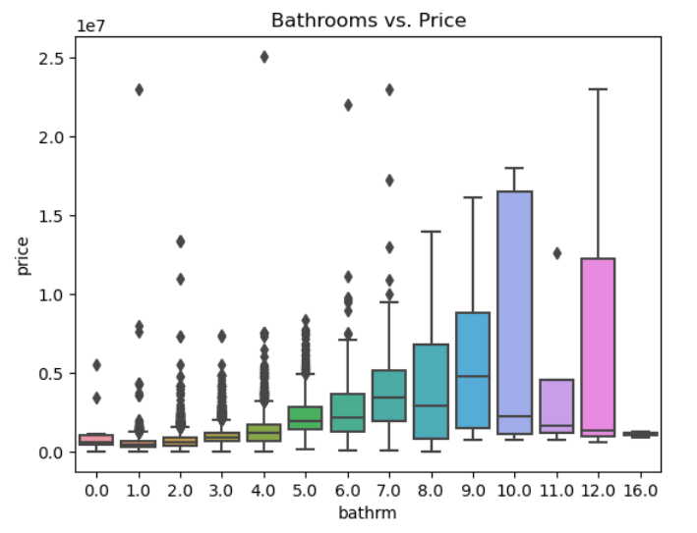
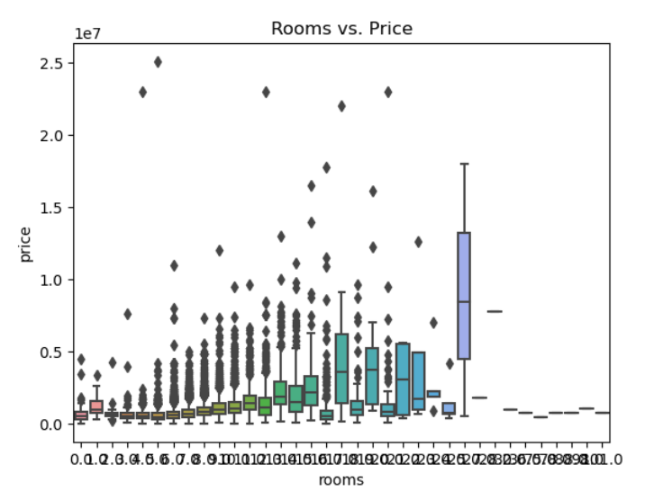
Property Sales by Price and Remodeled Status

Slide 22
Modeling

Slide 23
Model: Build LR model: adding cndtn as additional predictor variables
X : bathrm, bedrm, grade, heat, cndtn
Y: price
Mean squared error: 179811842021.4971
R-squared: 0.6258323459685577
Coefficients: [164265.84766985 13613.87467564 307118.1384096 2748.29253991
232516.50931523]
The model with additional predictor variables (heat and cndtn) has lower mean squared error and higher R-squared value, indicating an improved ability to predict sale price of residential properties.
The coefficient for bedrm is 13,613, indicating a positive correlation between the number of bedrooms and sale price.
The coefficient for grade is 307118, indicating a strong positive correlation between the grade and sale price.

Slide 24
Model: Build LR model: adding cndtn as additional predictor variables
X : bathrm, bedrm, grade, heat, cndtn
Y: price
A one-unit increase in the number of bedrooms is associated with a $13,613 increase in sale price.
There is a positive correlation between the number of bedrooms and sale price.
A one-unit increase in grade is associated with a $307,118 increase in sale price.
There is a strong positive correlation between grade and sale price.

Slide 25
Model: Build LR model: Adding gross building area another predictor
X : bathrm, bedrm, grade, heat, cndtn, gba
Y: price
=== Linear Regression Summary ===
Independent variables: ['bathrm', 'bedrm', 'grade', 'heat', 'cndtn', 'gba']
Dependent variable: price
Training data size: 22042
Test data size: 5511
Mean squared error: 152592231522.07385
R-squared: 0.682473208381842
Coefficients: [ 3.79435424e+04 -7.84834220e+04 2.13460032e+05 9.15830054e+01
2.58998466e+05 4.47272630e+02]

Slide 26

Model: Build LR model: Adding to model num_days_passed as pred
X : bathrm, bedrm, grade, heat, cndtn, gbr, num_days_passed
Y: price
Mean squared error: 131087096746.1664
R-squared: 0.7272229075021551
Coefficients: [ 3.26280674e+04 -8.13377908e+04 2.11012082e+05 -1.96497148e+02
2.10808357e+05 4.65268891e+02 1.09292253e+02]
The difference in R-squared values between the two models is not extremely large.
Still bedrm has a negative effect on price

Slide 27
Model: Build LR model: Adding gross building area another predictor
Which variables have an impact on sale price, and how strong is that impact? - Is there a correlation between the number of bedrooms and the sale price of a residential property in this dataset? - Is there a correlation between the grade and the sale price of a residential property in this dataset?
Yes, there is a correlation between the number of bedrooms and the sale price of a residential property in this dataset. However, the correlation is negative, meaning that as the number of bedrooms increases, the sale price tends to decrease.
Yes, there is a correlation between the grade and the sale price of a residential property in this dataset. The correlation is positive, meaning that as the grade of the property increases, the sale price tends to increase as well.

Slide 28

COVID-19 Impact

Slide 29
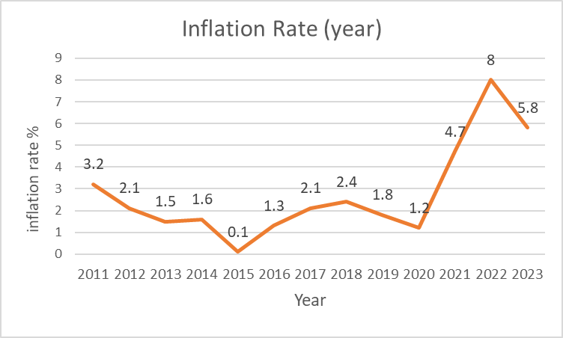
Covid impact
Selected periods:
ExAnte period: 2019-01-01~2020-02-29
During period: 2020-03-01~ 2021-07-31
ExPost period: 2021-08-01~2022-12-31
The obvious price changes before and after the COVID event.
In order to reduce the impact of price changes on house prices, the house prices are deflated by the inflation rate.

Slide 30
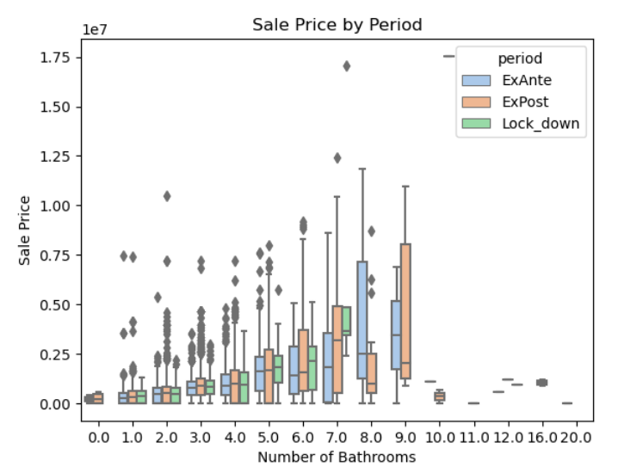
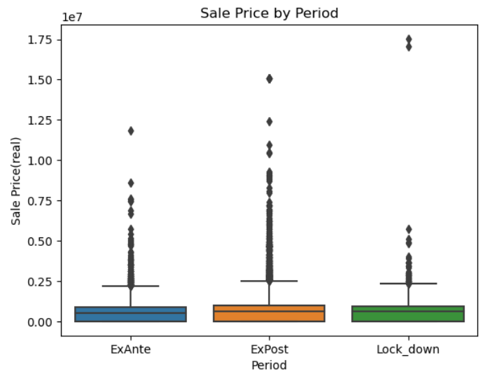
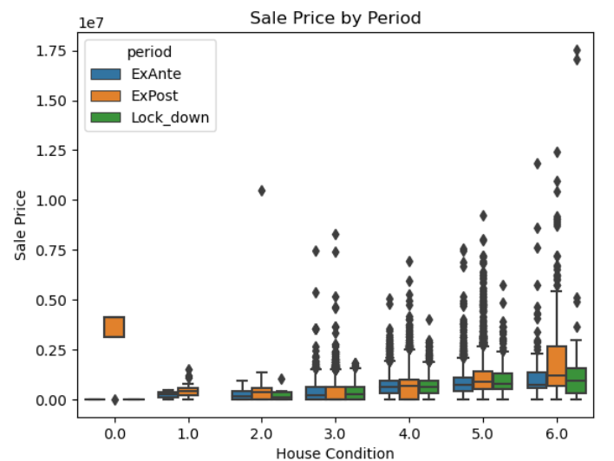
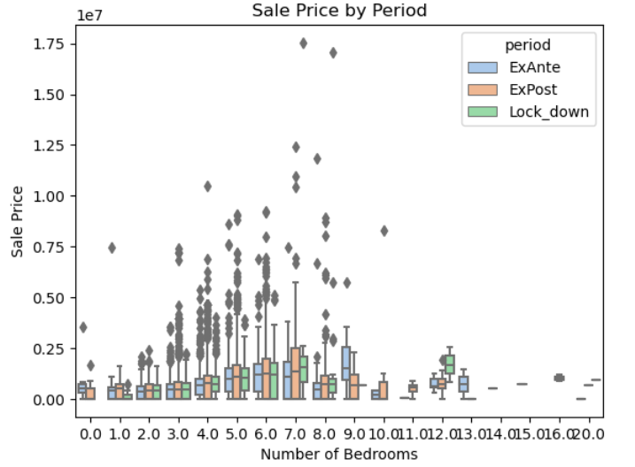
Covid impact
In comparing the house price levels with the number of bedrooms, and the number of bathrooms, the condition of house, there seem to be different price levels between the three periods.

Slide 31
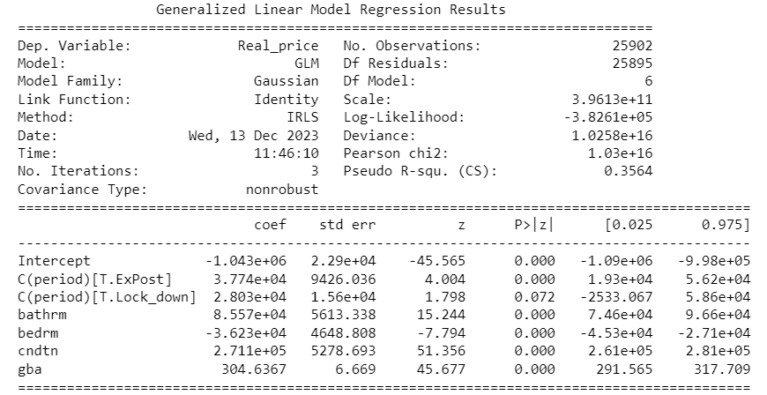
Covid impact
The period has positive impact on housing price.
Compared Ex-ante period, whether during or after Covid, housing price increased.

Slide 32
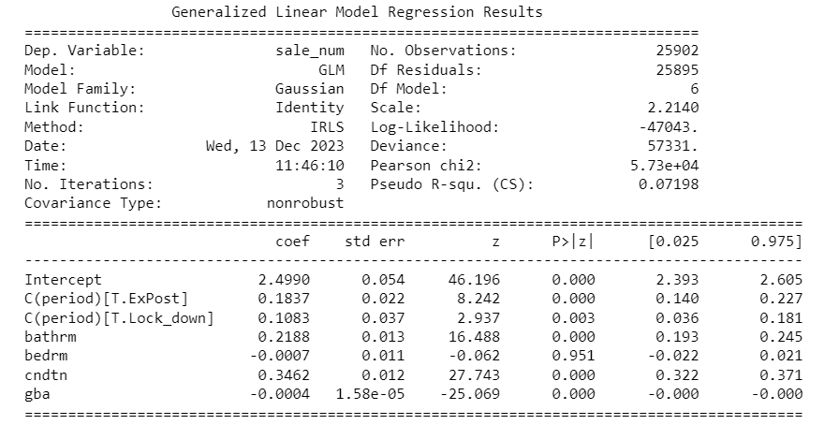
Covid impact
The period has positive impact on sales volume.
Compared Ex-ante period, whether during or after Covid, sales volume increased.

Slide 33
Covid impact
What reasons boost the housing market?
An increase in the demand for housing is associated first with social distancing and quarantining, and with the widespread adoption of work from home technology. (J Hous Econ., 2023)
During the pandemic, very low mortgage interest rates raised the demand for housing. The pandemic also boosted the demand for housing by increasing the need to work from home and for more socially distanced housing away from dense urban areas (Federal Reserve Bank of Dallas, 2021).

Slide 34
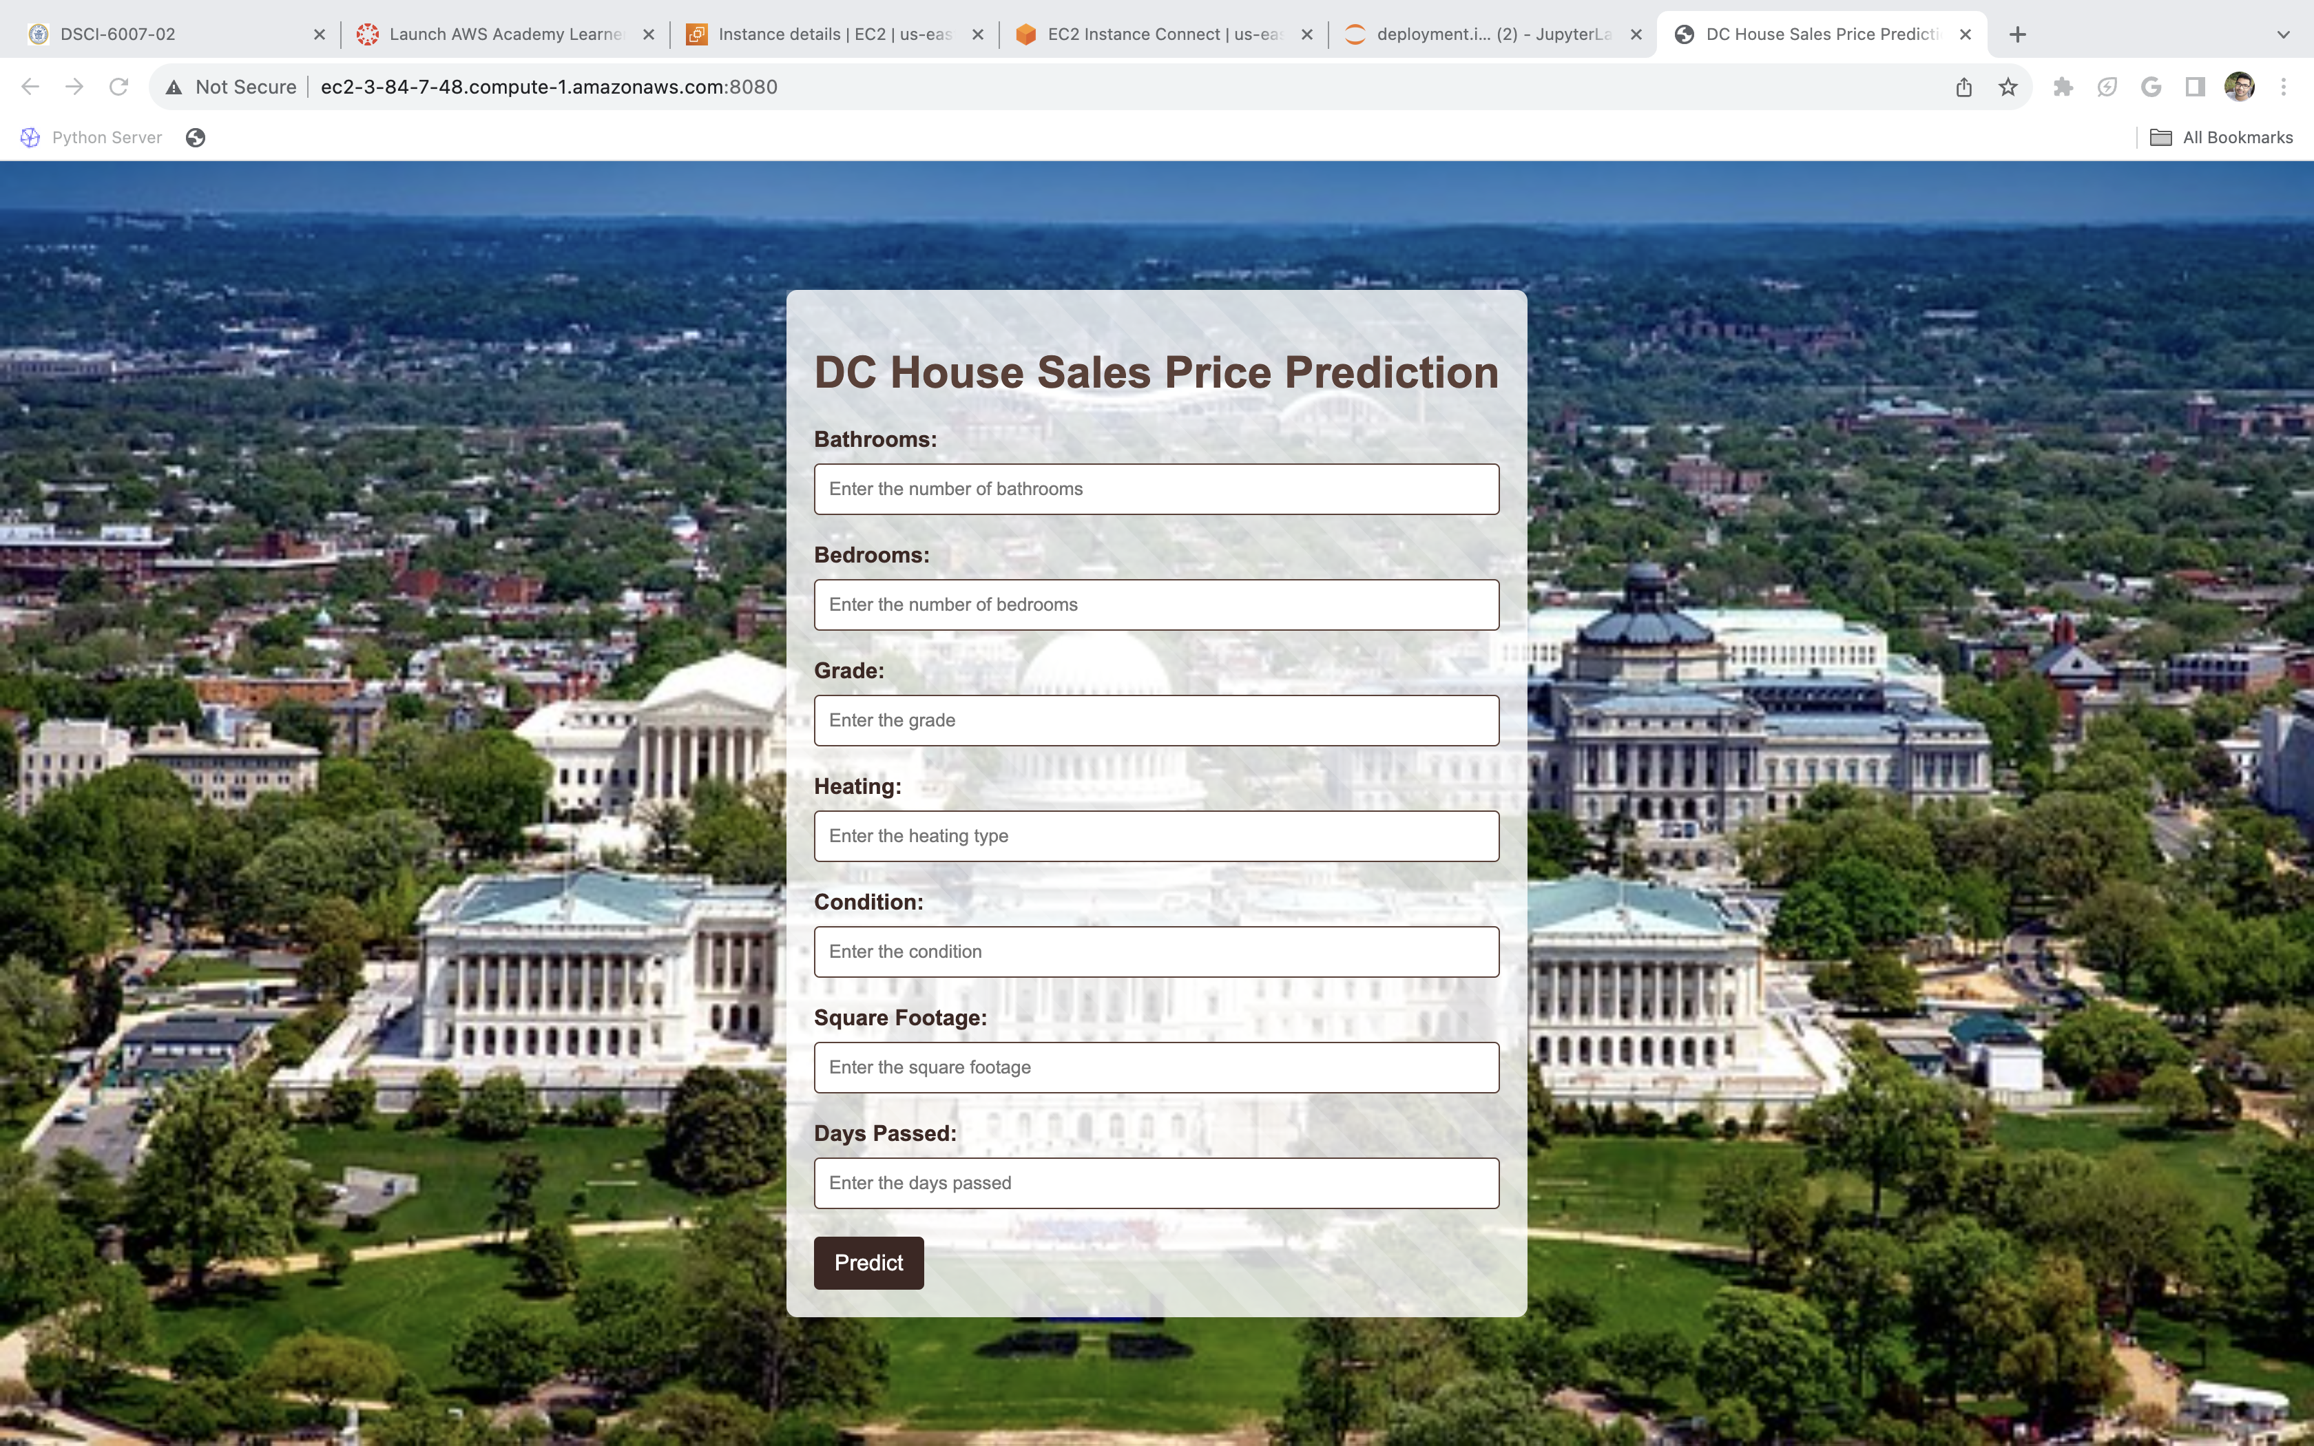
Deployment:

Slide 35


Slide 36
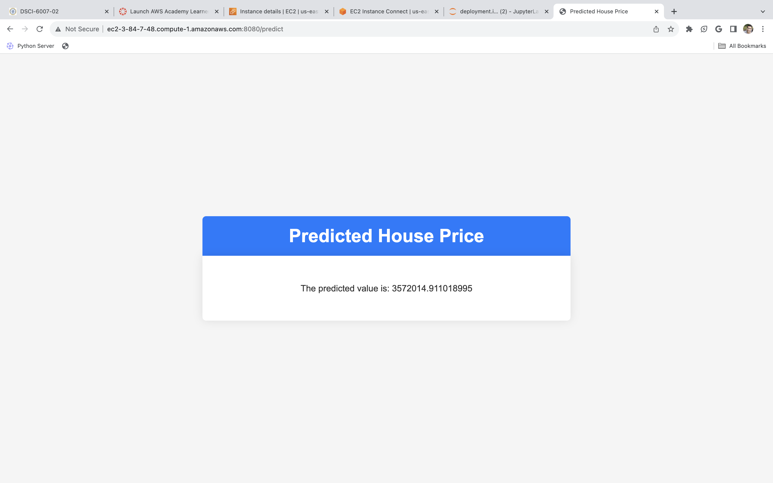

Slide 37
Reference
Schwartz, A. E., & Wachter, S. (2022). COVID-19’S IMPACTS ON HOUSING MARKETS: INTRODUCTION. Journal of Housing Economics.
John V. Duca, Anthony Murphy (2021). Why House Prices Surged as the COVID-19 Pandemic Took Hold. Federal Reserve Bank of Dallas. https://www.dallasfed.org/research/economics/2021/1228
Hands-On Machine Learning with Scikit-Learn, Keras, and TensorFlow, 2nd Edition, by Aurelien Geron (O'Reilly). Copyright 2019 Kiwisoft S.A.S, 978-1-492-03264-9

